Slide 1
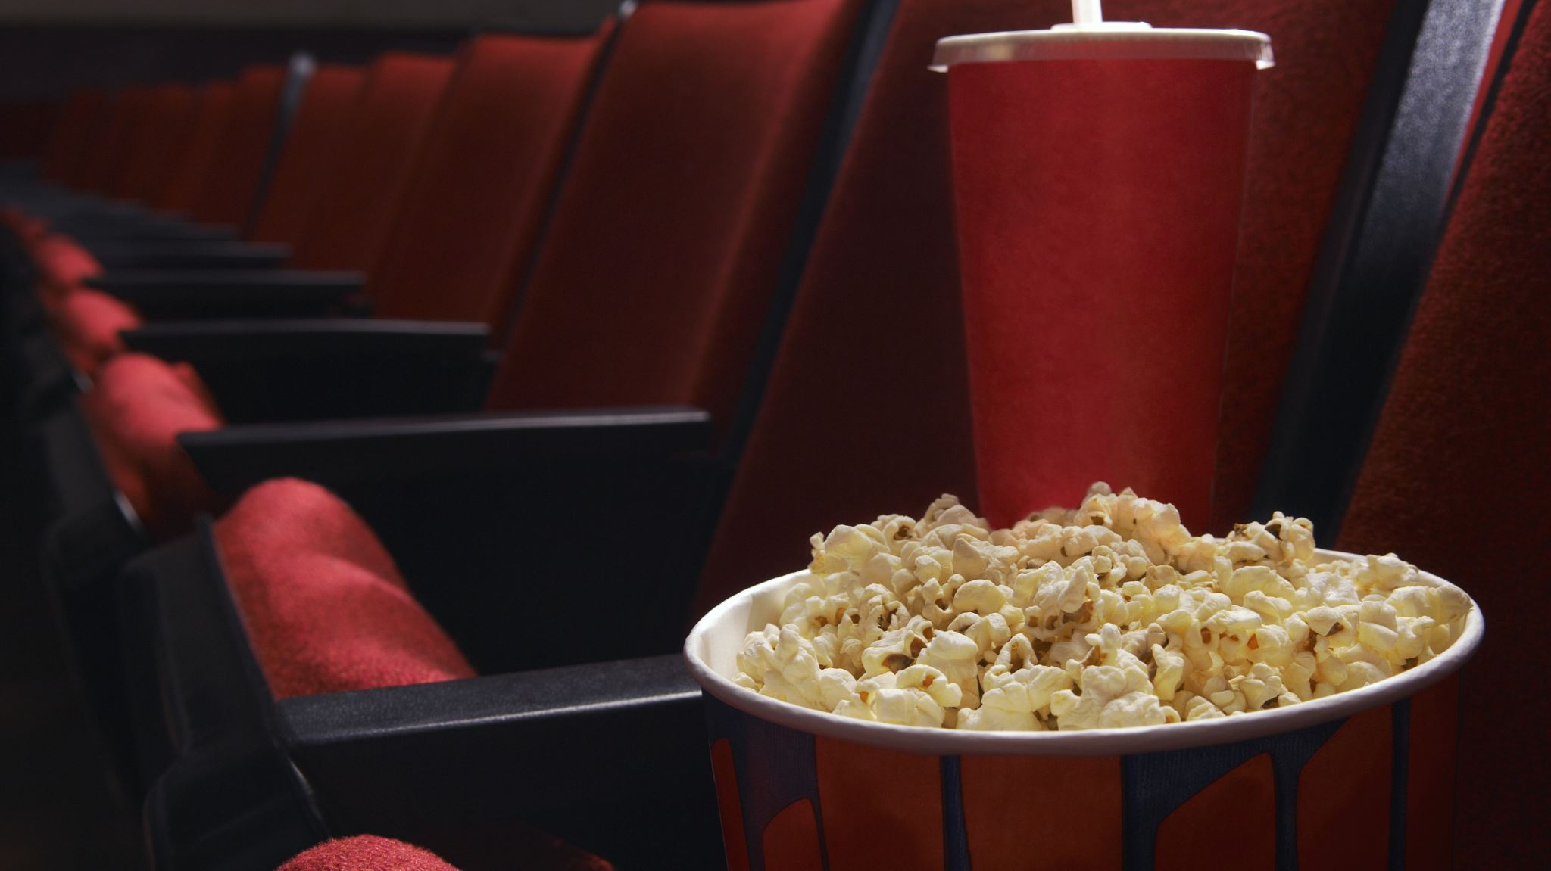
Movie recommendation And Streaming model

Slide 2
Main objective:
Create Machine Learning model to recommend similar movies
Integrate streaming api to stream all the recommended movies

Slide 3
Main objective:
Create Machine Learning model to recommend similar movies
Integrate streaming api to stream all the recommended movies

Slide 4
Main objective:
Create Machine Learning model to recommend similar movies
Integrate streaming api to stream all the recommended movies

Slide 5
Dataset info:
Kaggle top 5000 movies (tmdb) Dataset
Movies till 2016 only in the list
Recommendation on movie name and Tags
Tags is cast, genre, Director and summary combined

Slide 6

Model creation
Text vectorization using Bag of words method
NLTK library used to normalize similar words
Used cosine similarity between vectors to identify similar movies
Used streamlit to get user input and generate the output

Slide 7
Streaming api:-
2embed.ru a Russian movie Streaming api used
All the streaming links open in external web browser to Protect from any copyright infringement

Slide 8
Legal compliance
All streaming links on platform already available on internet
No copyrighted file hosted on platform
For copyright takedown must contact the api owner

